Slide 1
Test Plan
Mini Project
Daniel Yogatama Maydiputra
QE Kelas A
Universitas Ma Chung

Slide 2
Purpose
Identify software component that need to be tested
Write list of needs to do the testing
Made Test Plan, Test Scenario, and Test Cases
Identify Software bugs/errors after doing testing
Background
The execution of software testing need to be done to ensure the quality of the software. So the software could be used and run well as mentioned in the software requirement planning. Testing will be done to prevent bugs / errors when the software runs.

Slide 3
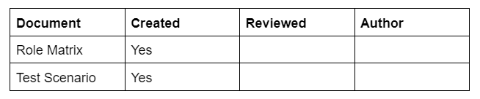
Scope
The Scope of testing includes :
Testing Alta Shop Website (https://qa.alta.id/)
Testing Alta Shop REST API (https://be-qa.alta.id/api)
Testing Mobile Apps (alta-online-shop.apk)
Project Identification

Slide 4
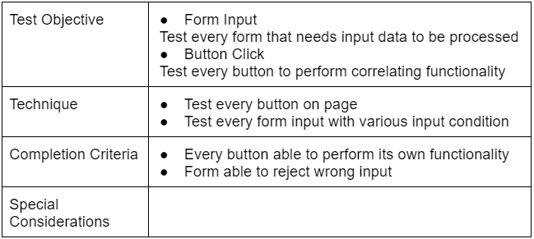
Functional Testing (Manual & Automation) Alta Shop Web

Slide 5
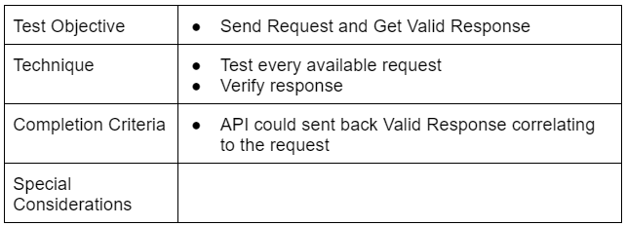
API Testing Alta Shop REST API

Slide 6
Testing Mobile Apps
alta-online-shop.apk

Slide 7
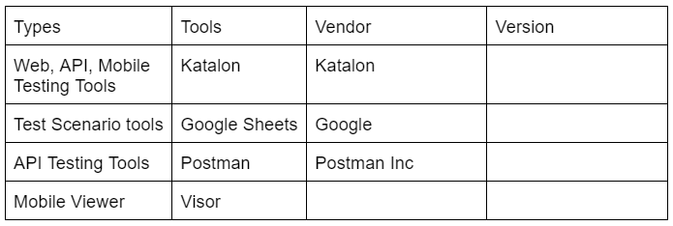
Tools

